Slide 1

RAHAT
Remote Application for Health Assistance And Tracking

Slide 2
RAHAT
Remote Application for Health Assistance And Tracking
Team 220 Volts
Kanav Bhasin (Email: kanavbhasin22@gmail.com)
Daksh Nauni (Email: mr.codefrost@gmail.com)
Yakshit Gupta (Email: guptayakshit@gmail.com)

Slide 3
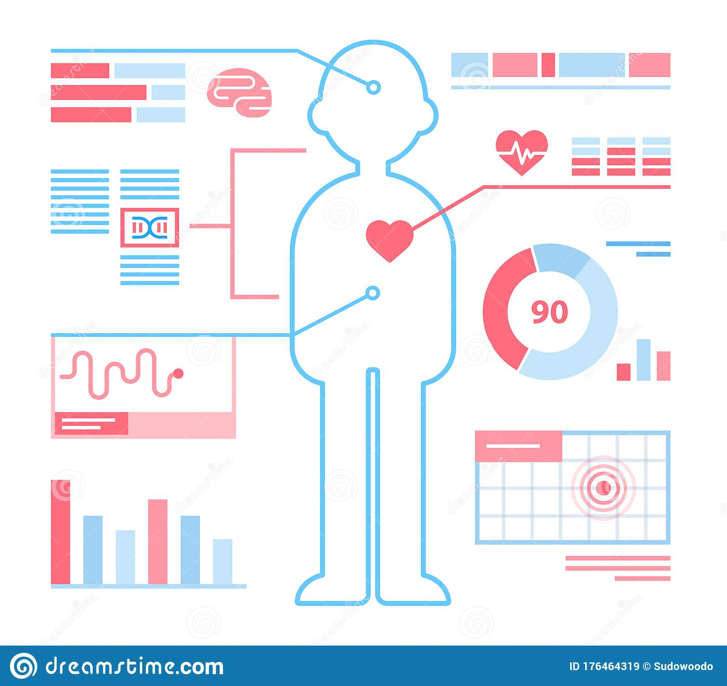
WHAT IS RAHAT ?
RAHAT implements sensor technology and internet to communicate to the loved ones in case of problems.
This system also shows patients temperature and heartbeat tracked live data with timestamps over the Internetwork.
Using the cloud nearby hospitals can access the data and help the patient if in case of an emergency.

Slide 4

WHY RAHAT ?
The current health monitoring systems are not Portable.
The patient cant able to understand the analog signals.
Complex system and difficult to operate.

Slide 5
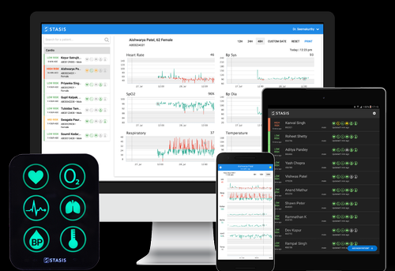
MOTIVE BEHIND RAHAT
The specialist at a distance can monitor the patient condition so that he can save the life.
This system is to be available at reasonable prices.
Embedded technology is to be use for monitoring the patient condition easily

Slide 6
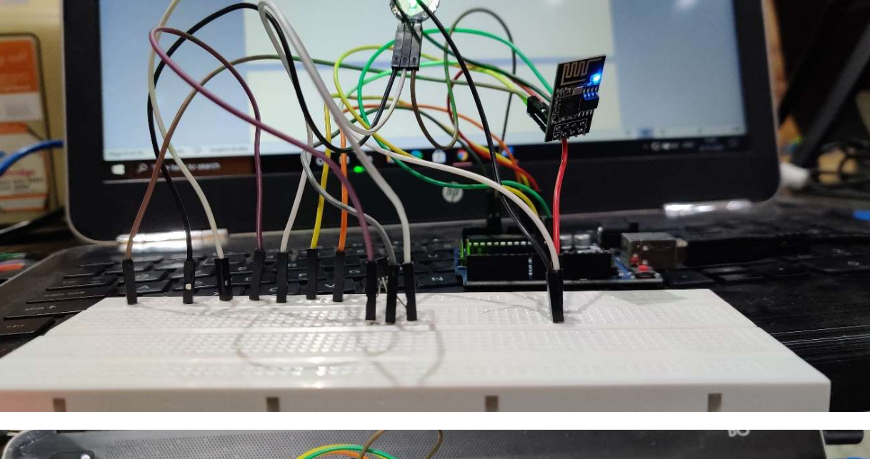
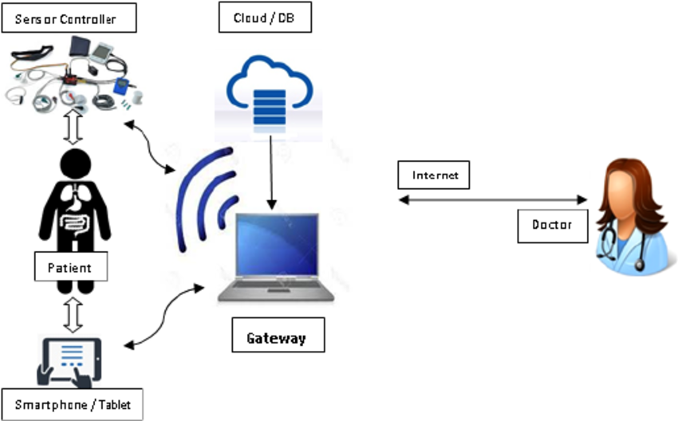
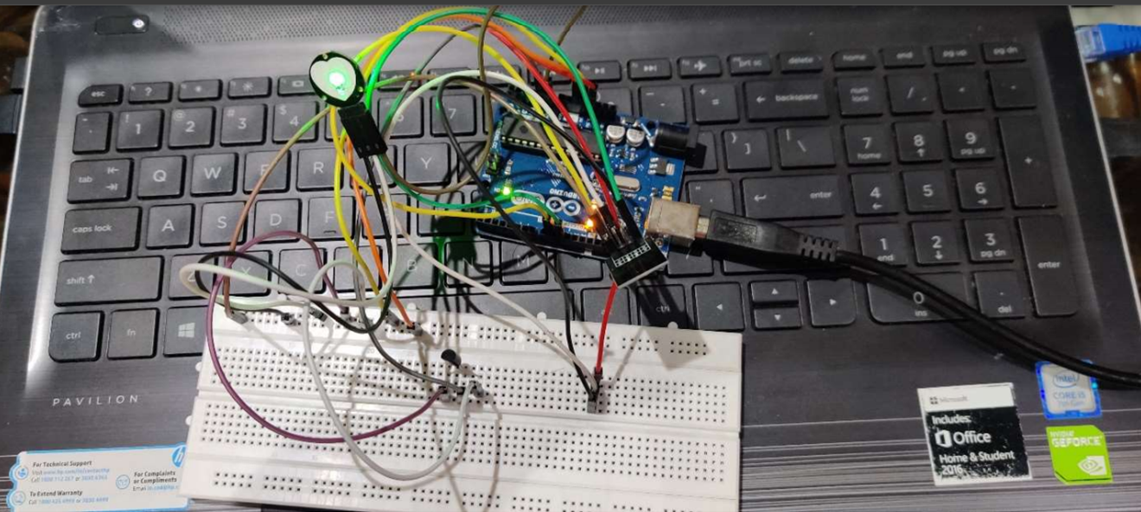
HARDWARE

Slide 7
BUSINESS IDEA
RAHAT as a business
TARGET AUDIENCE
BUDGET
This is product intentioned towards more of health than money . So ideally it would be available for healthcare centers and hospitals from where patients can rent it .
Also, there will be a provision for buying the product.
Currently old age patients who need constant monitoring but don’t have enough assets to get such services. Hence , this is our target audience.
PUBLICITY
FEASABILITY AND USAGE
We will try to use google ad services to promote our product.
Further our publicity involves collaboration with ministry of agriculture of India.
Since this is basically a Health support app, so therefore most of the public would use our product to monitor their health .
This also helps to connect directly to Specialist who can help the concerned.

Slide 8
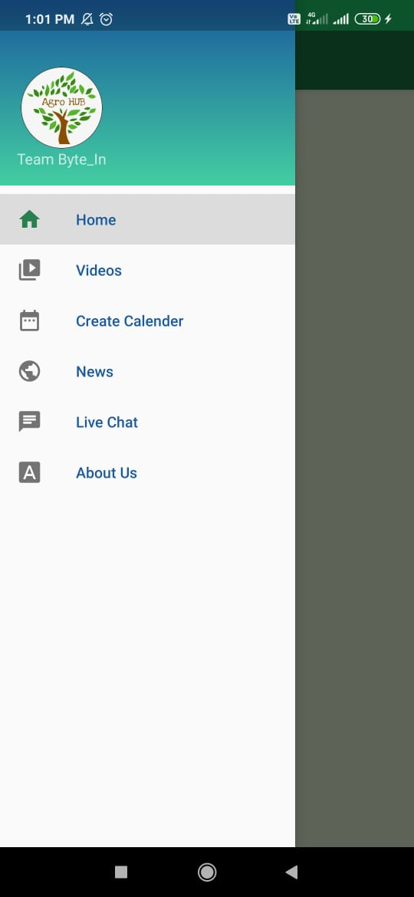
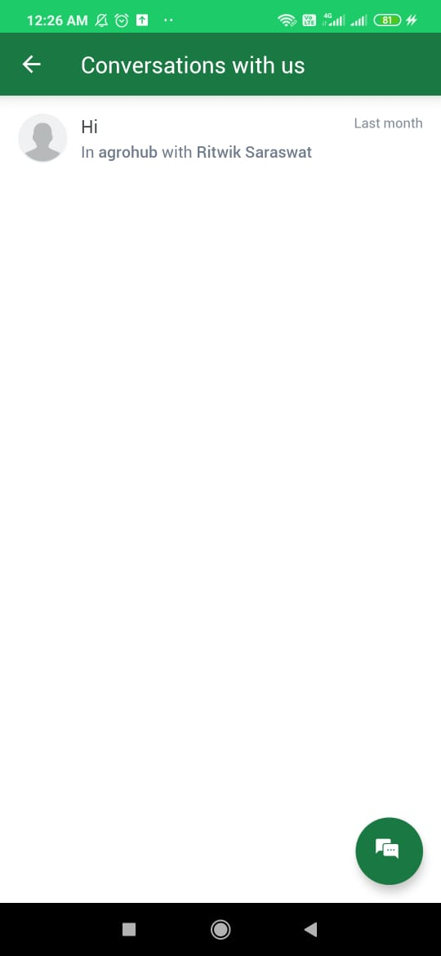
RAHAT
The mobile app has been developed as a smart portal for end-users integrated with a push notification service .
It also has other features like COVID-19 News, videos .
The app has an authentication feature also.

Slide 9
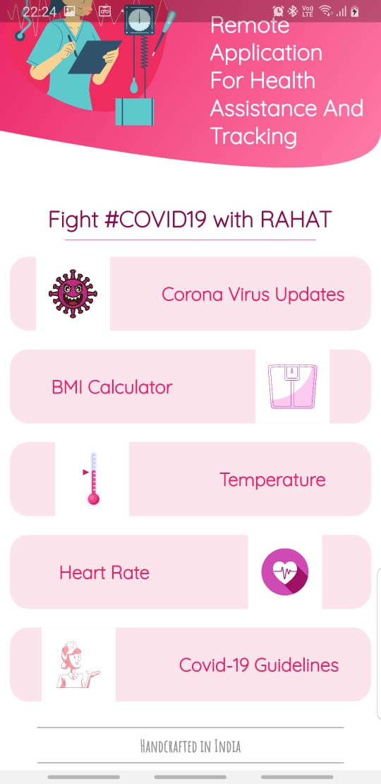
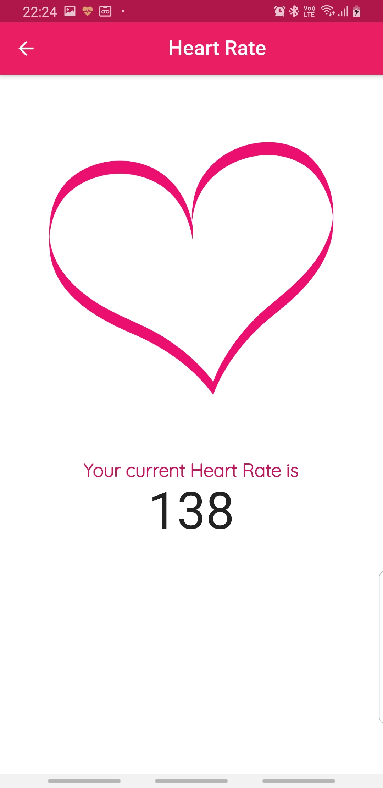
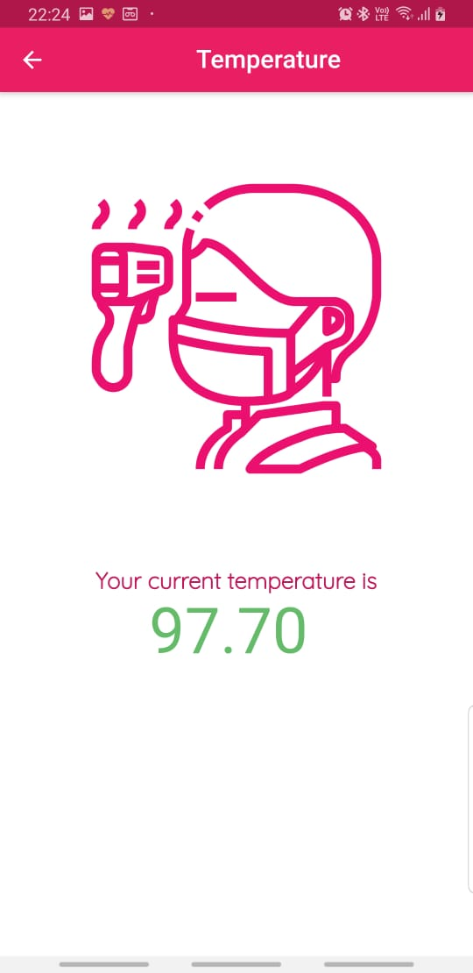
Screenshot of the Application

Slide 10
MOBILE APPLICATION
Features of RAHAT app
HealthVideos
All health related videos in one place.
Live chat
Chat with experts and coordinators through the app.
notifications
COVID News
Get notified of all the live stats of your health.
All COVID related news integrated in the applications

Slide 11
THANK FOR WATCHING

